Slide 1

PCWG Intelligence Sharing Initiative Update
13 December 2016
Glasgow, Scotland
Peter Stuart & Andy Clifton (NREL)

Slide 2
PCWG-Share-X: What are we Trying to Achieve?
Motivation:
Solution:
There are currently many candidate methods for predicting turbine performance in outer range conditions, but no consensus about which method works best.
The Power Curve Working Group Intelligence Sharing Initiative (PCWG-Share-X) aims to objectively test many methods for predicting outer range turbine performance in order to determine which works best.
The industry has a wealth of historic power performance data whose full potential is yet to be realised.
The Power Curve Working Group Intelligence Sharing Initiative (PCWG-Share-X) aims to unlock the full value of our industry’s data.
The PCWG Intelligence Sharing Initiative enables the industry to pool the value of many datasets without actually sharing any commercially sensitive data.

Slide 3
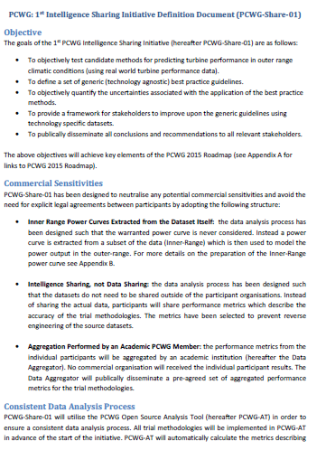
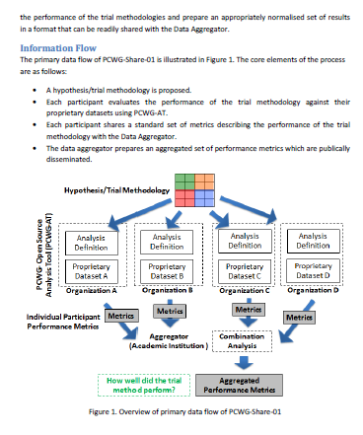
PCWG-Share-X Definition Document
Everything you need to know about PCWG-Share-X
Download PCWG-Share-01 Definition Doc from www.pcwg.prg

Slide 4
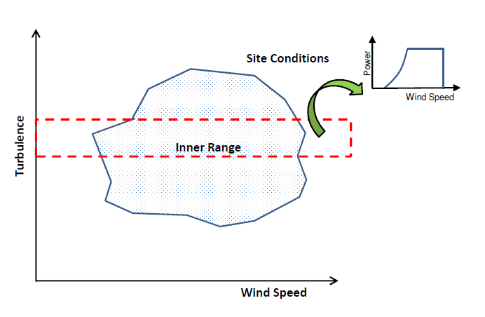
PCWG-Share-X: Neutralising Commercial Sensitivities
Inner Range Power Curves Extracted from the Dataset Itself: the data analysis process has been designed such that the warranted power curve is never considered. Instead a power curve is extracted from a subset of the data (Inner-Range) which is then used to model the power output in the outer-range.
Intelligence Sharing, not Data Sharing: the data analysis process has been designed such that the datasets do not need to be shared outside of the participant organisations. Instead of sharing the actual data, participants will share performance metrics which describe the accuracy of the trial methodologies.
PCWG-Share-X does not involve sharing the sales power curve.
PCWG-Share-X does not involve sharing time series data.

Slide 5
PCWG-Share-X: Data Flow
Hypothesis/Trial Methodology
Analysis Definition Y
Analysis Definition Y
Analysis Definition Y
Analysis Definition Y
Proprietary Dataset A
Proprietary Dataset B
Proprietary Dataset C
Proprietary Dataset D
Organization A
Organization B
Organization C
Organization D
Hypothesis Performance Metrics
Aggregator
(NREL)
Combination Analysis
How well did the trial method perform?
Aggregated Hypothesis Performance Metrics

Slide 6
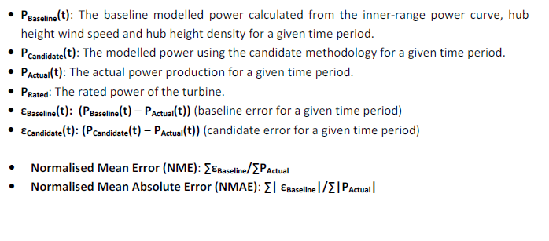
PCWG-Share-X: Error Metric Definitions
For NME to be zero a method must be right on average
For NMAE to be zero a method must be right all the time
See PCWG-Share-01 Definition Document for Further Details

Slide 7
PCWG-Share-X Original Timeline
PCWG-Share-1
≈50 participant datasets (4 remote sensing datasets)
3 method tested (REWS, IEC Turbulence Correction & Power Deviation Matrix)
Calculation Issues: Interpolation Errors and Erroneous Outliers
Dec 2015
PCWG-Share-1.1
Objective: to iron out the issues experienced during PCWG-Share-1
Two week turn-around
≈44 participant datasets (11 remote sensing datasets)
Same 3 method tested (REWS, IEC Turbulence Correction & Power Deviation Matrix)
Streamlined participation process
PCWG-Share-1 Calculation Issues Resolved
Sept2016
Oct to
Dec
2016
PCWG-Share-2
Objective: to test more methods and expand to more datasets
Target: 100 participant datasets (25 remote sensing datasets)
Additional methods to be tested e.g. 3D Power Deviation Matrix & REWS with Upflow
Refined results analysis
Behind Schedule, sorry! (more later)

Slide 8
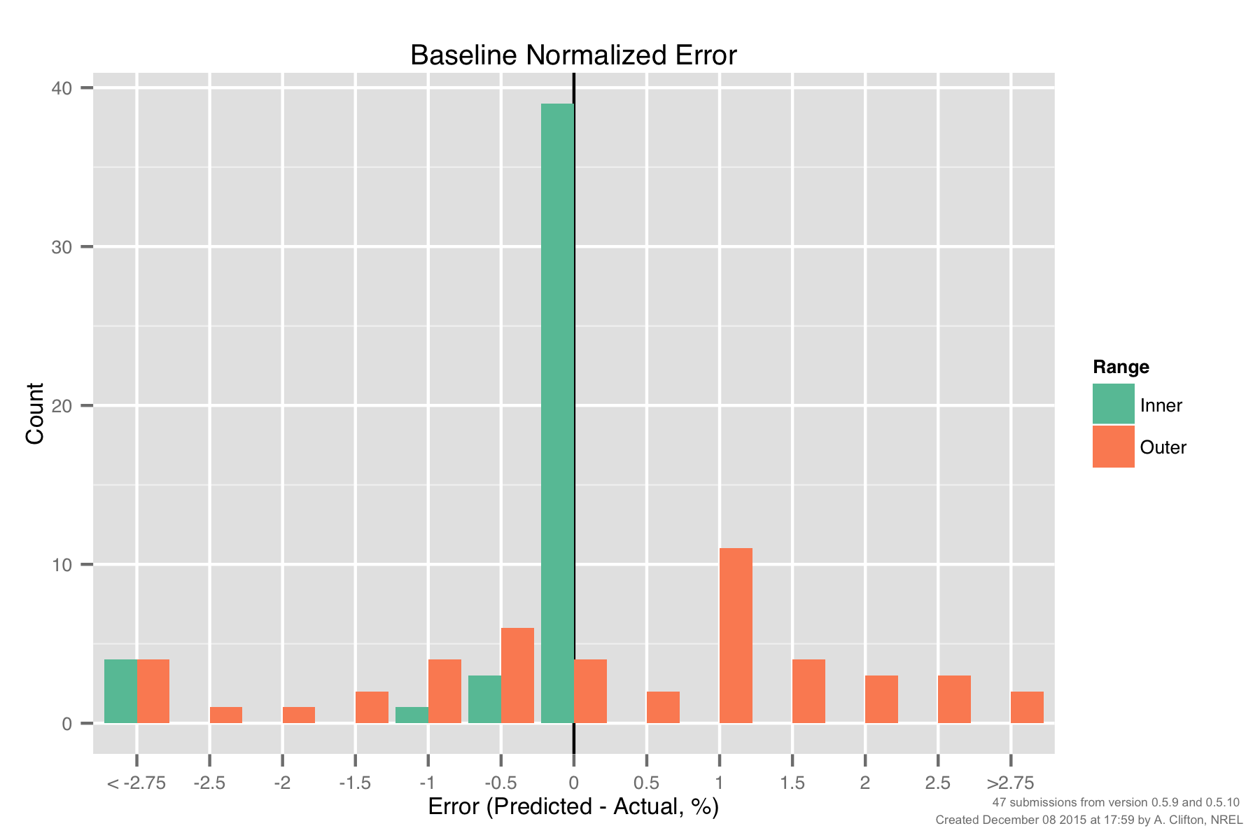
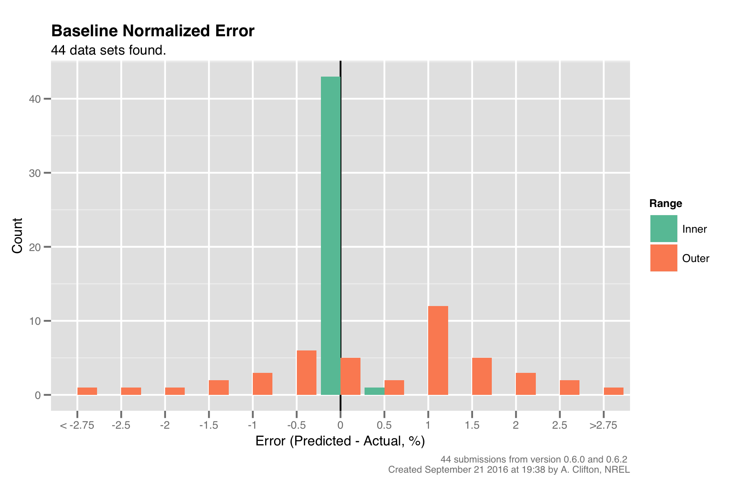
PCWG-Share-1 vs PCWG-Share-1.
Baseline normalised error i.e. before any correction
PCWG-Share-1.1
PCWG-Share-1
Erroneous Outliers: unexpectedly large errors for baseline inner range
Spread of Baseline Outer Range Results, indicates why Outer Range Corrections are required
Baseline Issues Resolved
Interpolation Issue: Smaller inner baseline errors still undesirable

Slide 9
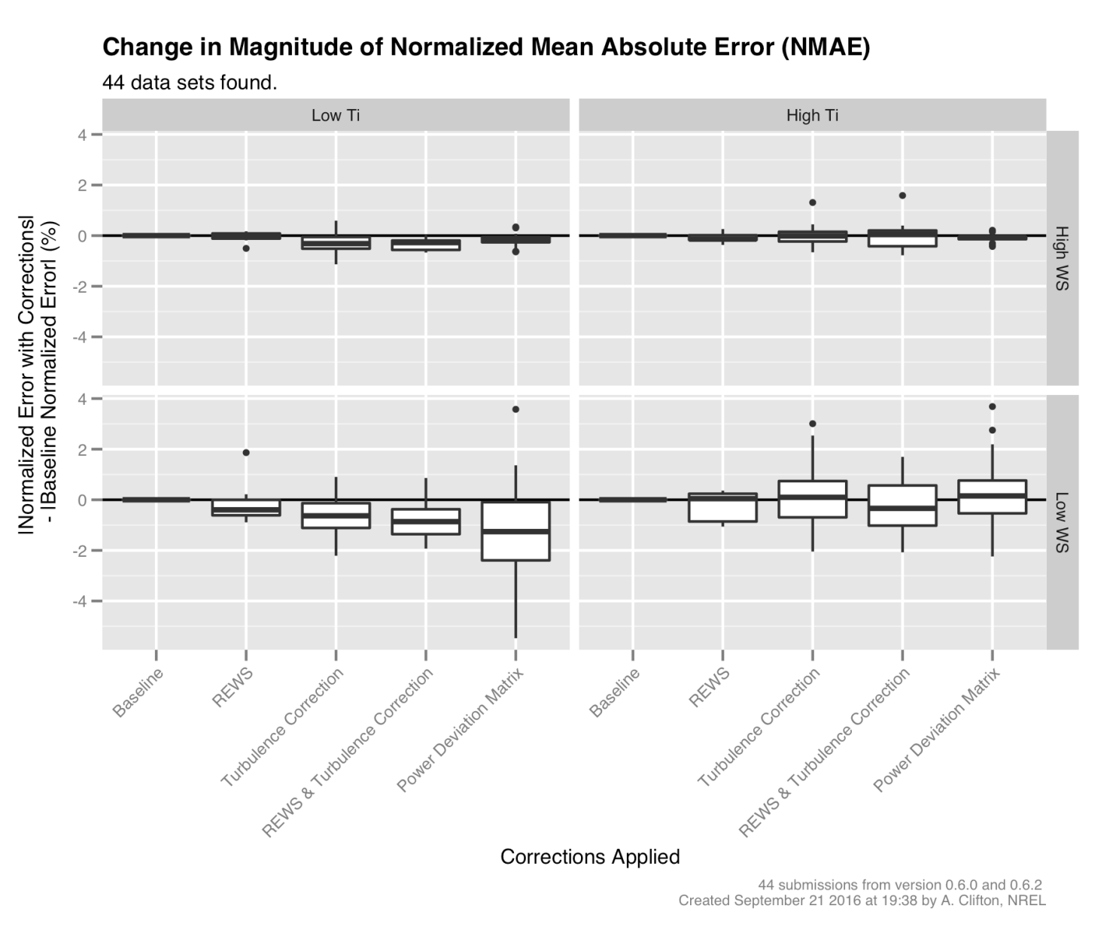
PCWG-Share-1.1 Comparison of Methods (‘Four Cell’ Matrix)
Low Turbulence
High Turbulence
Worse
Seek to determine which methods work well when.
High Wind Speed
Better
Percentage Reduction in Error
PCWG-Share-2 to expand upon these results.
Worse
Low Wind Speed
Better
Baseline
REWS
REWS
Turb Corr
Baseline
Turb Corr
REWS & Turb Corr
Power Dev Matrix
REWS & Turb Corr
Power Dev Matrix

Slide 10
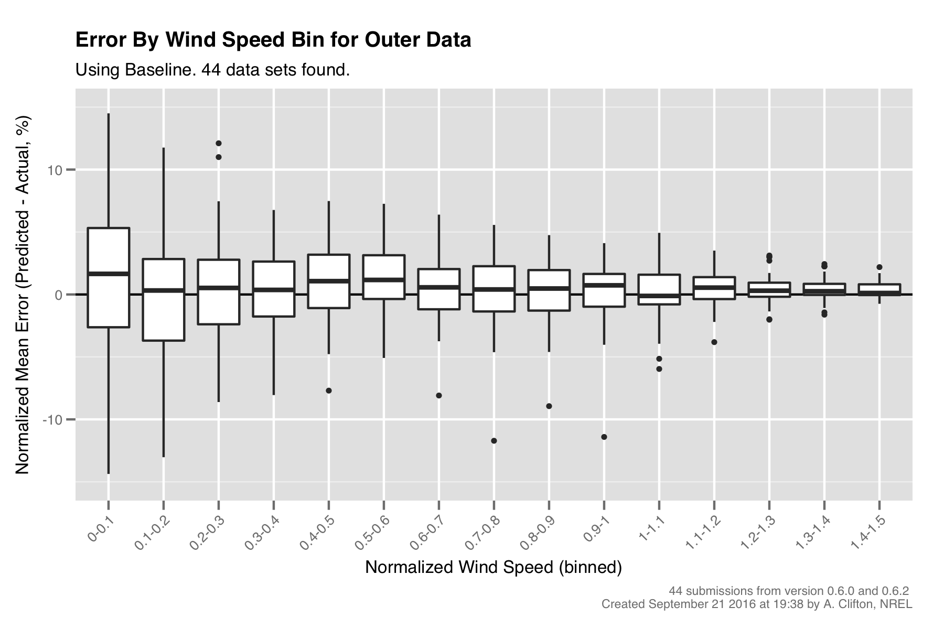
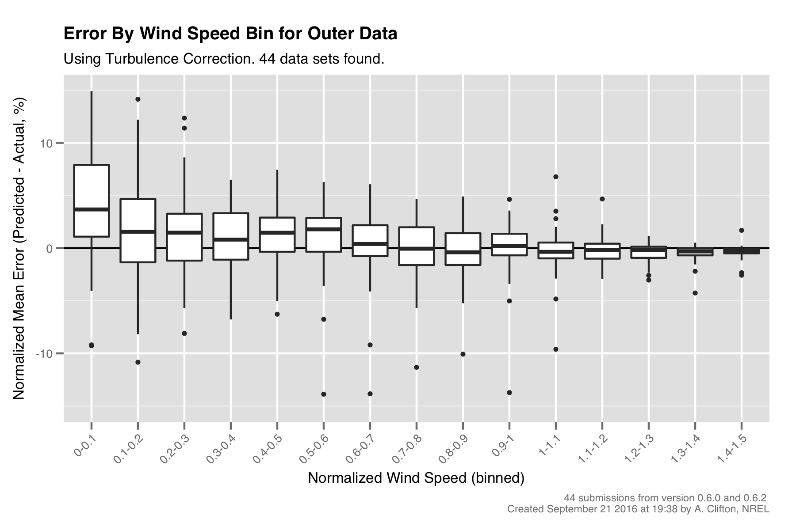
PCWG-Share-1.1 Power IEC Turbulence Correction
(errors by wind speed)

Slide 11
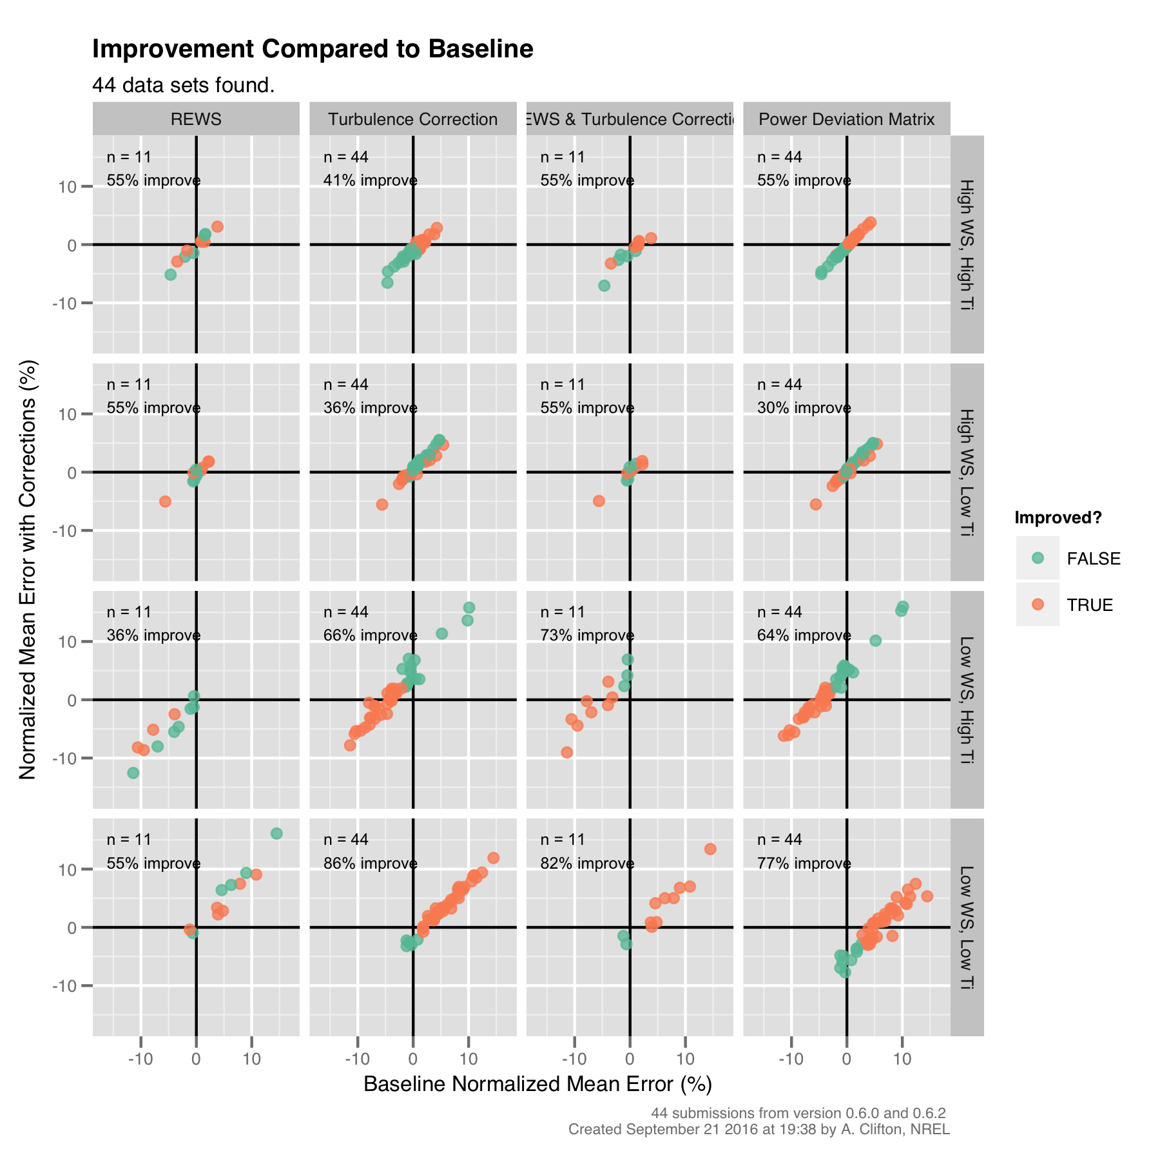

Slide 12
PCWG-Share-2 Proposed Plan
Proposed PCWG-Share-2 Methods:
REWS with Upflow (see August Pamplona proceedings for details).
3D power deviation matrix
All previous methods (REWS, Turbulence, 2D Power Deviation Matrix)
Production by Height (added following feedback at US PCWG meeting)
All methods now implemented in PCWG Tool
Dataset Target:
100 participant datasets (25 remote sensing datasets)
Remaining software task of adding new method to anonymous export
Proposed PCWG-Share-2 Revised Timeline:
Early-Jan: Release of Software with new methods implemented
End of February: Submission deadline
March/April: Presentation of results at 1st PCWG meeting of 2017
Possible PCWG-Share-3 Methods
Machine Learning (more later from Andy Clifton)
Modified Turbulence Correction (see August Pamplona PCWG proceedings for details)
BEM based model: simple model (e.g. approach proposed by Prevailing) or full aero-elastic (e.g. FAST)

Slide 13
Questions/Discussion
PCWG-Share-2 Methods
Have the right methods been proposed for PCWG-Share-2?
Improvements to Error Metrics & Visualisations
What improvements could be made to how method errors are reported/visualised e.g. expressing by wind speed errors as fraction of total energy instead of bin energy
Making the Process Easier
What improvements could be made to make participation faster and easier?

Slide 14
Many thanks to all PCWG-Share-X Participants
Join the Power Curve Working Group at: www.pcwg.org

